Slide 1
Data Cleaning and Manipulation in R
Github.com/danawanzer
Click “data-cleaning-manipulation-training”
Click “Clone or download”, “Download ZIP”
OR
Click “R Training Worksheet.Rmd” and copy-paste into an Rmd file.
INSTALL PACKAGES IF YOU DO NOT HAVE THEM ALREADY!

Slide 2
readxl
dat <- readxl::read_xlsx(“../data.xlsx”)
Notes:
Have everyone raise their hand and lower it once they’ve heard of one of the packages I mention:
Readxl
Haven
Ggplot2
Presumably everyone will have lowered their hands by this point.

Slide 3
haven
dat <- haven::read_sav(“../data.sav”)
Notes:
Have everyone raise their hand and lower it once they’ve heard of one of the packages I mention:
Readxl
Haven
Ggplot2
Presumably everyone will have lowered their hands by this point.

Slide 4
ggplot2
ggplot(data = dat, aes(x)) +
geom_histogram()
Notes:
Have everyone raise their hand and lower it once they’ve heard of one of the packages I mention:
Readxl
Haven
Ggplot2
Presumably everyone will have lowered their hands by this point.

Slide 5
tidyverse
readxl
dplyr
ggplot2
tidyr
haven
stringr
forcats
tibble
readr
purrr
and more!
Notes:
What do all of these packages have in common?
They’re all part of the tidyverse!

Slide 6
tidyverse
readxl
dplyr
ggplot2
tidyr
haven
stringr
forcats
tibble
readr
purrr
and more!
Notes:
What do all of these packages have in common?
They’re all part of the tidyverse!

Slide 7













import
tidy
transform
visualize
model
program
Notes:
Describe the tidyverse:
Collection of pacakages all under the same principles (which are…)
Developed by Hadley Wickham but now hundreds of people contribute to the tidyverse
The ones shown here are just a few of the main core packages of the tidyverse but there are a ton more out there.
Describe the tidyverse process:
Most people are familiar with the beginning and end pieces of this process
But it’s the middle that probably takes the most time from us, yet the one we’re not often taught explicitly. My goal here is for you to come away from this training knowing a little bit about how to do this work.

Slide 8
getting started
#install and load the following packages
library(tidyverse) #dplyr, tidyr, and more
library(psych) #downloading for bfi data
library(summarytools) #used for dfSummary()
library(janitor) #used for other data cleaning
#Load in bfi dataset
data(bfi)
describe(bfi)

Slide 9
viewing the data
View(bfi) #note the uppercase v
base::summary(bfi)
psych::describe(bfi)
dplyr::glimpse(bfi)
view(summarytools::dfSummary(bfi))
Notes:
What are some ways we can view our data?

Slide 10
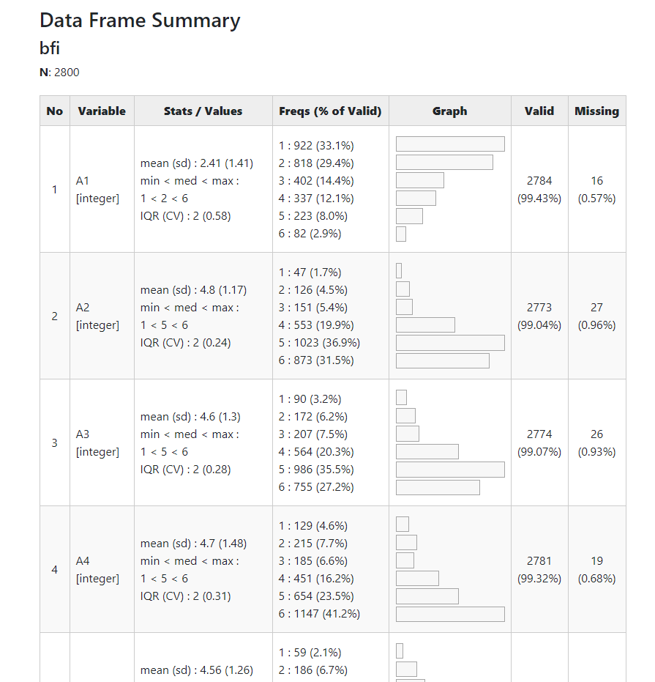

Slide 18
Notes:
Look through the data frame summary yourself. What are some of the things you notice?
Some values probably need to be reverse-coded
Gender and education are being treated as an integer when really they’re nominal and ordinal, respectively
There are rownames of IDs that aren’t showing up there

Slide 19
select
filter
arrange
mutate
summarize

Slide 20
select
dat_new <- dat$var
dat_new <- dat[“var”]
dat_new <- dat[1]
dat_new <- dat[c(“var1”, “var2”)]
dat_new <- dat[c(1:5)]
Notes:
Imagine you are working with a dataset and you only need one variable from that dataset. How would you go about pulling out just that variable?
Now, how do you do that but with multiple variables?
Not bad solutions, but a ton of parentheses and brackets. You have to add quotations around variable names or you need to know their position. And what if you have to do tons of variables? There has to be a better way!

Slide 21
select
dat_new <- select(dat,
var1, var2)
dat_new <- select(dat,
1, 4, 9)
dat_new <- select(dat,
var1, 4, var2)
Notes:
Super easy syntax, right? But that’s not where the select function is most useful.

Slide 22
select
de-
dat_new <- select(dat,
-var75)
Notes:
Imagine I have 100 variables. I want to drop one variable from the dataset. How would you go about doing that?
The minus sign

Slide 23
select
dat_new <- select(dat,
newname = var1)
dat_new <- rename(dat,
newname = var1)
Notes:
What about renaming variables? A cinch within the select function. Just write the new name equals the old name!
Alternatively, the rename function does the exact same thing.

Slide 24
select
dat_new <- select(dat,
starts_with(“Q1_”))
dat_new <- select(dat,
ends_with(“R”))
dat_new <- select(dat,
contains(“T1”))
Notes:
Imagine you’re working in Qualtrics. You have a scale and you had Qualtrics number the variables so they all start with Q1 for one scale, Q2 for another, and so on. You just want the first scale. How do you do that?
You could just list all of the variables, Q1_1, Q1_2, etc. but there has to be a better way, right?
There is!

Slide 25
select
dat_new <- select(dat,
starts_with(“Q9”),
everything())
dat_new <- select(dat,
-starts_with(“Q1”))
Notes:
Okay, now imagine you download your Qualtrics data and because of the survey flow your variables are out of order. Or maybe you just want your primary outcome variable at the beginning of your dataset so you can see it easier. Just select those variables and then put everything() at the end!

Slide 26
select
dat_new <- select_if(dat,
is.numeric)
dat_new <- select_if(dat,
is.character)
Notes:
Now imagine you are working with that same Qualtrics dataset and there’s a bunch of qual data you’re going to analyze in another software, so you don’t need it in R. You just need the numeric data. Can we get rid of it? Easily!

Slide 27

Notes:
Stone Cold Steve Austin says it’s your turn!

Slide 28
filter
filter(dat,
age == 18)
filter(dat,
age == 18 | age == 19)
filter(dat,
is.na(age))
Notes:
Filter is to rows as select is to columns.
NOTE THE DOUBLE EQUALS!

Slide 29
filter
filter(dat,
age == 18 & education == 1)
filter(dat,
age == 18 | education == 1)
filter(dat,
age == 18 & !education == 1)

Slide 30
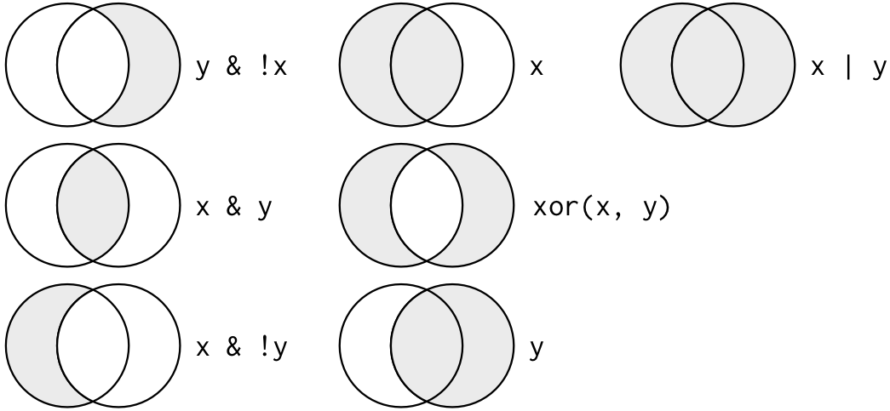
filter operators
Comparison
Logical
>
<
>=
<=
== (equal)
!= (not equal)

Slide 31
arrange
arrange(dat,
age)
arrange(dat,
desc(age))
Notes:
Arrange is to reordering rows as select can reorder columns.

Slide 32
Notes:
Stone Cold Steve Austin says it’s your turn!

Slide 33
Combining it all so far
dat1 <- select(dat,
starts_with(“Q1”), age)
dat1 <- filter(dat1, age >= 18)
dat1 <- arrange(dat1, age)
Notes:
Let’s put it together. Assume I have a dataset and I want just Q1 and age,
I want to filter out the people 18 and older
And then I just want to double-check that worked by using the arrange feature.
How annoying is that?! Not only am I assigning to new dataset each row, but I’m writing the name of the dataset over and over.

Slide 34
Combining it all so far
wth?!
dat %>%
select(starts_with(“Q1”),
age)) %>%
filter(age >= 18) %>%
arrange(age)
Notes:
This is what the code looks like simplified.
You’re probably looking at it like what the heck is going on?! What is that percent, greater than, percent thing?
That is called a pipe.

Slide 35
pipe
f(x, y) == x %>% f(y)
You can call it the pipe,
or just read it as “then”
Notes:
The pipe essentially pulls out the first argument of a function, typically the dataset, into it’s own line and pipes it into every subsequent function you call. So let’s go back to the previous example.

Slide 36
Combining it all so far
dat1 <-
dat %>%
select(starts_with(“Q1”),
age)) %>%
filter(age >= 18) %>%
arrange(age)
Notes:
First, we’re going to call the dataset we’re going to work with, then put the pipe after it. We will no longer have to call the dataset again!
Then, we use our next verb and go straight to what we want to do with the dat dataset without calling it because the pipe told it to use the dat dataset already!
THEN we filter for individuals greater than 18.
THEN we arrange ascending by age.
If we want, we can even assign the results of what we do to a dataset. Notice again, we only do this once!

Slide 37

Notes:
Stone Cold Steve Austin says we’ll wait a bit until we try out the pipe ☺ he’s not convinced yet of how cool it is

Slide 38
mutate
dat %>%
mutate(age = 2019 – year_born)
dat %>%
mutate(minutes = seconds * 60)
dat %>%
transmute(minutes = seconds * 60)
Notes:
This creates new columns based on math.
The transmute option is similar to the mutate option except that it returns ONLY the resulting columns you’ve created, not all of them. Mutate returns your dataset PLUS your new columns.

Slide 39
Mutate – row mean/sum
dat %>%
mutate(Total = rowSums(.[c(1:5)],
na.rm = TRUE)
dat %>%
mutate(Avg = rowMeans(.[c(1:5)],
na.rm = TRUE)
wth?!
Notes:
Unfortunately, creating means of scales is not as intuitive as one might like in dplyr. One day I hope they fix this but for now this is what we have to work with.
You’re probably wondering what the dot is. Can anyone guess? It is the filler for the dataset name, or “dat!” In this case, we are calling the dataset again but the pipe doesn’t know how to deal with that so we put a period to indicate to R that the dataset name goes here again.

Slide 40
Mutate – row mean/sum
rowSums(.[startsWith(names(.), “Q1”)]
rowSums(.[endsWith(names(.), “R”)]
Notes:
We can still use the startsWith, endsWith, and contains words here. But note the extra work we have to do here. We have to specifically say it’s the names of the dataset we’re working with. Can anyone notice the other thing that’s different?
We don’t use an underscore with startsWith and endsWith. Instead, the W is capitalized. This is because we’re using the base R functions, not the dplyr functions! So this isn’t the prettiest solution, but once you get the hang of it it works out great. There may be better packages out there for this work, however.

Slide 41
Notes:
Stone Cold Steve Austin says it’s your turn!

Slide 42
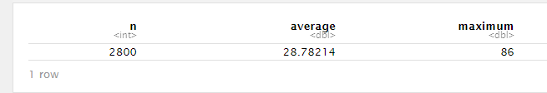
summarise
bfi %>%
summarise(n = n(),
average = mean(age),
maximum = max(age))
Notes:
With the summarise function, we can do summaries of a variety of statistics like the count, mean, max, min, standard deviation, sum, median, IQR, and more. We can even use math to create our own statistics if we’d like.
Note that I am using the UK variant of the word summarise. You can use the US version with the z, but I prefer not to use it because so many packages have the summarize function. Sometimes it uses the wrong one and I’d rather just ensure it’s using the dplyr summarise and not some other package’s summarize.
Note the output though. We just get the summary for the entire dataset. Sometime’s that’s great, but usually we want grouped summaries.

Slide 43
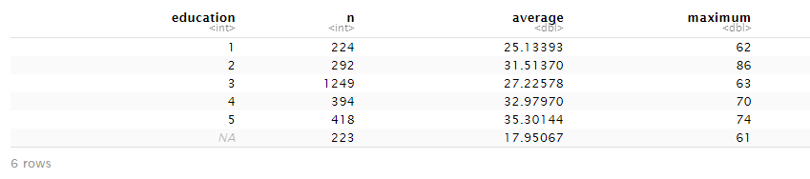
summarise
bfi %>%
group_by(education) %>%
summarise(n = n(),
average = mean(age),
maximum = max(age))
Notes:
If we group_by education first, then we can see the summary statistics for the entire dataset grouped by education levels. This is going to be really useful for getting those descriptive tables you often see in the methods or results sections of papers.
Let’s think for a moment: how would we get rid of the NA values for education?
We would need to add a line of filter(!is.na(education)) before summarise.

Slide 44
summarise
bfi %>%
group_by(education) %>%
filter(!is.na(education)) %>%
summarise(n = n(),
average = mean(age),
maximum = max(age))
Notes:
If we group_by education first, then we can see the summary statistics for the entire dataset grouped by education levels.
Let’s think for a moment: how would we get rid of the NA values for education?
We would need to add a line of filter(!is.na(education)) before summarise.

Slide 45
summarise
bfi %>%
summarise(A = ci.reliability[.c(1:5)]$est,
C = ci.reliability[.c(6:10)]$est,
E = ci.reliability[.c(11:15)]$est,
N = ci.reliability[.c(16:20)]$est,
O = ci.reliability[.c(21:25)]$est)
Notes:
We can also combine summarise with other statistics. For instance, here I’m combining with Hierarchical Omega to find out the reliability of the five sub-scales.

Slide 46
scoped variants
_all: performs function on all columns
_if: requires a function that returns a Boolean (i.e., TRUE or FALSE); if true, it does the next step
_at: requires to specify columns inside vars()
Notes:
Before we practice the summarise function, I want to share with you the scoped variants of the verbs we just learned. They all have these three scoped variants.

Slide 47
scoped variants
select_if(is.numeric)
summarise_if(is.numeric,
mean, na.rm = TRUE)
filter_all(!any_vars(. == 99))
mutate_at(vars(c(1:25)),
mean, na.rm = TRUE)
Notes:
For instance, we already learned about select_if before.

Slide 48
Notes:
Stone Cold Steve Austin says it’s your turn!

Slide 49
gather
spread
separate
unite

Slide 50
gather
 | key | value
gather()
apreshill/teachthat
Notes:
(1)

Slide 51
Dataset
you have
Columns
you have
gather(juniors_untidy,
key = “spice”, value = “correct”, cinnamon_1:nutmeg_3)
key column you want
Value column you want
apreshill/teachthat
Notes:
Colored around code

Slide 52
gather(juniors_untidy,
key = “spice”, value = “correct”, cinnamon_1:nutmeg_3)
baker | cinnamon_1 | cardamom_2 | nutmeg_3
Emma | 1 | 0 | 1
Harry | 1 | 1 | 1
Ruby | 1 | 0 | 1
Zainab | 0 | NA | 0
baker | spice | correct
Emma | cinnamon_1 | 1
Harry | cinnamon_1 | 1
Ruby | cinnamon_1 | 1
Zainab | cinnamon_1 | 0
Emma | cardamom_2 | 0
Harry | cardamom_2 | 1
Ruby | cardamom_2 | 0
Zainab | cardamom_2 | NA
Emma | nutmeg_3 | 1
Harry | nutmeg_3 | 1
Ruby | nutmeg_3 | 1
Zainab | nutmeg_3 | 0
apreshill/teachthat
Notes:
(2)

Slide 53
gather(juniors_untidy,
key = “spice”, value = “correct”, cinnamon_1:nutmeg_3)
baker | cinnamon_1 | cardamom_2 | nutmeg_3
Emma | 1 | 0 | 1
Harry | 1 | 1 | 1
Ruby | 1 | 0 | 1
Zainab | 0 | NA | 0
baker | spice | correct
Emma | cinnamon_1 | 1
Harry | cinnamon_1 | 1
Ruby | cinnamon_1 | 1
Zainab | cinnamon_1 | 0
Emma | cardamom_2 | 0
Harry | cardamom_2 | 1
Ruby | cardamom_2 | 0
Zainab | cardamom_2 | NA
Emma | nutmeg_3 | 1
Harry | nutmeg_3 | 1
Ruby | nutmeg_3 | 1
Zainab | nutmeg_3 | 0
apreshill/teachthat
Notes:
(3)

Slide 54
gather(juniors_untidy,
key = “spice”, value = “correct”, cinnamon_1:nutmeg_3)
baker | cinnamon_1 | cardamom_2 | nutmeg_3
Emma | 1 | 0 | 1
Harry | 1 | 1 | 1
Ruby | 1 | 0 | 1
Zainab | 0 | NA | 0
baker | spice | correct
Emma | cinnamon_1 | 1
Harry | cinnamon_1 | 1
Ruby | cinnamon_1 | 1
Zainab | cinnamon_1 | 0
Emma | cardamom_2 | 0
Harry | cardamom_2 | 1
Ruby | cardamom_2 | 0
Zainab | cardamom_2 | NA
Emma | nutmeg_3 | 1
Harry | nutmeg_3 | 1
Ruby | nutmeg_3 | 1
Zainab | nutmeg_3 | 0
apreshill/teachthat
Notes:
(4)

Slide 55
gather(juniors_untidy,
key = “spice”, value = “correct”, cinnamon_1:nutmeg_3)
baker | cinnamon_1 | cardamom_2 | nutmeg_3
Emma | 1 | 0 | 1
Harry | 1 | 1 | 1
Ruby | 1 | 0 | 1
Zainab | 0 | NA | 0
baker | spice | correct
Emma | cinnamon_1 | 1
Harry | cinnamon_1 | 1
Ruby | cinnamon_1 | 1
Zainab | cinnamon_1 | 0
Emma | cardamom_2 | 0
Harry | cardamom_2 | 1
Ruby | cardamom_2 | 0
Zainab | cardamom_2 | NA
Emma | nutmeg_3 | 1
Harry | nutmeg_3 | 1
Ruby | nutmeg_3 | 1
Zainab | nutmeg_3 | 0
apreshill/teachthat
Notes:
(5)

Slide 56
gather(juniors_untidy,
key = “spice”, value = “correct”, cinnamon_1:nutmeg_3)
baker | cinnamon_1 | cardamom_2 | nutmeg_3
Emma | 1 | 0 | 1
Harry | 1 | 1 | 1
Ruby | 1 | 0 | 1
Zainab | 0 | NA | 0
baker | spice | correct
Emma | cinnamon_1 | 1
Harry | cinnamon_1 | 1
Ruby | cinnamon_1 | 1
Zainab | cinnamon_1 | 0
Emma | cardamom_2 | 0
Harry | cardamom_2 | 1
Ruby | cardamom_2 | 0
Zainab | cardamom_2 | NA
Emma | nutmeg_3 | 1
Harry | nutmeg_3 | 1
Ruby | nutmeg_3 | 1
Zainab | nutmeg_3 | 0
apreshill/teachthat
Notes:
(6)

Slide 57
gather(juniors_untidy,
key = “spice”, value = “correct”, cinnamon_1:nutmeg_3)
baker | cinnamon_1 | cardamom_2 | nutmeg_3
Emma | 1 | 0 | 1
Harry | 1 | 1 | 1
Ruby | 1 | 0 | 1
Zainab | 0 | NA | 0
baker | spice | correct
Emma | cinnamon_1 | 1
Harry | cinnamon_1 | 1
Ruby | cinnamon_1 | 1
Zainab | cinnamon_1 | 0
Emma | cardamom_2 | 0
Harry | cardamom_2 | 1
Ruby | cardamom_2 | 0
Zainab | cardamom_2 | NA
Emma | nutmeg_3 | 1
Harry | nutmeg_3 | 1
Ruby | nutmeg_3 | 1
Zainab | nutmeg_3 | 0
apreshill/teachthat
Notes:
(7)

Slide 58
gather(juniors_untidy,
key = “spice”, value = “correct”, cinnamon_1:nutmeg_3)
baker | cinnamon_1 | cardamom_2 | nutmeg_3
Emma | 1 | 0 | 1
Harry | 1 | 1 | 1
Ruby | 1 | 0 | 1
Zainab | 0 | NA | 0
baker | spice | correct
Emma | cinnamon_1 | 1
Harry | cinnamon_1 | 1
Ruby | cinnamon_1 | 1
Zainab | cinnamon_1 | 0
Emma | cardamom_2 | 0
Harry | cardamom_2 | 1
Ruby | cardamom_2 | 0
Zainab | cardamom_2 | NA
Emma | nutmeg_3 | 1
Harry | nutmeg_3 | 1
Ruby | nutmeg_3 | 1
Zainab | nutmeg_3 | 0
apreshill/teachthat
Notes:
Add caveat that you don’t have to write out key = and value = but they have to be in that order and come first.

Slide 59
gather(juniors_untidy,
key = “spice”, value = “correct”, -baker)
baker | cinnamon_1 | cardamom_2 | nutmeg_3
Emma | 1 | 0 | 1
Harry | 1 | 1 | 1
Ruby | 1 | 0 | 1
Zainab | 0 | NA | 0
baker | spice | correct
Emma | cinnamon_1 | 1
Harry | cinnamon_1 | 1
Ruby | cinnamon_1 | 1
Zainab | cinnamon_1 | 0
Emma | cardamom_2 | 0
Harry | cardamom_2 | 1
Ruby | cardamom_2 | 0
Zainab | cardamom_2 | NA
Emma | nutmeg_3 | 1
Harry | nutmeg_3 | 1
Ruby | nutmeg_3 | 1
Zainab | nutmeg_3 | 0
apreshill/teachthat
Notes:
You can also specify which columns not to include when gathering.

Slide 60
spread
 | key | value
spread()
apreshill/teachthat
Notes:
Spread is the complement to gather.

Slide 61
Dataset
you have
Columns
you have
spread(juniors_untidy, key = “spice”, value = “correct”)
Contains the cell values you want
Contains the column names you want
apreshill/teachthat
Notes:
Colored around code

Slide 62
spread(juniors_untidy, key = “spice”, value = “correct”)
baker | spice | correct
Emma | cinnamon_1 | 1
Harry | cinnamon_1 | 1
Ruby | cinnamon_1 | 1
Zainab | cinnamon_1 | 0
Emma | cardamom_2 | 0
Harry | cardamom_2 | 1
Ruby | cardamom_2 | 0
Zainab | cardamom_2 | NA
Emma | nutmeg_3 | 1
Harry | nutmeg_3 | 1
Ruby | nutmeg_3 | 1
Zainab | nutmeg_3 | 0
baker | cinnamon_1 | cardamom_2 | nutmeg_3
Emma | 1 | 0 | 1
Harry | 1 | 1 | 1
Ruby | 1 | 0 | 1
Zainab | 0 | NA | 0
apreshill/teachthat
Notes:
(8)

Slide 63
separate
baker | spice | correct
Emma | cinnamon_1 | 1
Harry | cinnamon_1 | 1
Ruby | cinnamon_1 | 1
Zainab | cinnamon_1 | 0
Emma | cardamom_2 | 0
Harry | cardamom_2 | 1
Ruby | cardamom_2 | 0
Zainab | cardamom_2 | NA
Emma | nutmeg_3 | 1
Harry | nutmeg_3 | 1
Ruby | nutmeg_3 | 1
Zainab | nutmeg_3 | 0
baker | spice_name | num | correct
Emma | cinnamon | 1 | 1
Harry | cinnamon | 1 | 1
Ruby | cinnamon | 1 | 1
Zainab | cinnamon | 1 | 0
Emma | cardamom | 2 | 0
Harry | cardamom | 2 | 1
Ruby | cardamom | 2 | 0
Zainab | cardamom | 2 | NA
Emma | nutmeg | 3 | 1
Harry | nutmeg | 3 | 1
Ruby | nutmeg | 3 | 1
Zainab | nutmeg | 3 | 0

Slide 64
separate(juniors_untidy, spice, c(“spice”, “num”))
baker | spice | correct
Emma | cinnamon_1 | 1
Harry | cinnamon_1 | 1
Ruby | cinnamon_1 | 1
Zainab | cinnamon_1 | 0
Emma | cardamom_2 | 0
Harry | cardamom_2 | 1
Ruby | cardamom_2 | 0
Zainab | cardamom_2 | NA
Emma | nutmeg_3 | 1
Harry | nutmeg_3 | 1
Ruby | nutmeg_3 | 1
Zainab | nutmeg_3 | 0
baker | spice_name | num | correct
Emma | cinnamon | 1 | 1
Harry | cinnamon | 1 | 1
Ruby | cinnamon | 1 | 1
Zainab | cinnamon | 1 | 0
Emma | cardamom | 2 | 0
Harry | cardamom | 2 | 1
Ruby | cardamom | 2 | 0
Zainab | cardamom | 2 | NA
Emma | nutmeg | 3 | 1
Harry | nutmeg | 3 | 1
Ruby | nutmeg | 3 | 1
Zainab | nutmeg | 3 | 0

Slide 65
unite
baker | spice_name | num | correct
Emma | cinnamon | 1 | 1
Harry | cinnamon | 1 | 1
Ruby | cinnamon | 1 | 1
Zainab | cinnamon | 1 | 0
Emma | cardamom | 2 | 0
Harry | cardamom | 2 | 1
Ruby | cardamom | 2 | 0
Zainab | cardamom | 2 | NA
Emma | nutmeg | 3 | 1
Harry | nutmeg | 3 | 1
Ruby | nutmeg | 3 | 1
Zainab | nutmeg | 3 | 0
baker | spice | correct
Emma | cinnamon_1 | 1
Harry | cinnamon_1 | 1
Ruby | cinnamon_1 | 1
Zainab | cinnamon_1 | 0
Emma | cardamom_2 | 0
Harry | cardamom_2 | 1
Ruby | cardamom_2 | 0
Zainab | cardamom_2 | NA
Emma | nutmeg_3 | 1
Harry | nutmeg_3 | 1
Ruby | nutmeg_3 | 1
Zainab | nutmeg_3 | 0

Slide 66
unite(juniors_untidy, spice, spice_name, num)
baker | spice_name | num | correct
Emma | cinnamon | 1 | 1
Harry | cinnamon | 1 | 1
Ruby | cinnamon | 1 | 1
Zainab | cinnamon | 1 | 0
Emma | cardamom | 2 | 0
Harry | cardamom | 2 | 1
Ruby | cardamom | 2 | 0
Zainab | cardamom | 2 | NA
Emma | nutmeg | 3 | 1
Harry | nutmeg | 3 | 1
Ruby | nutmeg | 3 | 1
Zainab | nutmeg | 3 | 0
baker | spice | correct
Emma | cinnamon_1 | 1
Harry | cinnamon_1 | 1
Ruby | cinnamon_1 | 1
Zainab | cinnamon_1 | 0
Emma | cardamom_2 | 0
Harry | cardamom_2 | 1
Ruby | cardamom_2 | 0
Zainab | cardamom_2 | NA
Emma | nutmeg_3 | 1
Harry | nutmeg_3 | 1
Ruby | nutmeg_3 | 1
Zainab | nutmeg_3 | 0

Slide 67
putting it all together
I would like a summary table of the 25 BFI items with the mean, sd, min, and max.
How do I do that?
Notes:
See R and walk through the following:
bfi %>%
select(-age, -gender, -education) %>%
summarise_all(list(~mean(.), ~sd(.), ~min(.), ~max(.)), na.rm = TRUE) %>%
gather() %>%
separate(key, c("var", "fun")) %>%
spread(var, value)

Slide 68

janitor
clean_names
tabyl
Notes:
See R and walk through the following:
bfi %>%
select(-age, -gender, -education) %>%
summarise_all(list(~mean(.), ~sd(.), ~min(.), ~max(.)), na.rm = TRUE) %>%
gather() %>%
separate(key, c("var", "fun")) %>%
spread(var, value)

Slide 69
clean_names
test_df %>%
clean_names()
# first_name
# abc
# percent_success_2009
# repeat_value
# repeat_value_2
# x
names(test_df) <-
c("firstName",
"ábc@!*",
"% success (2009)",
"REPEAT VALUE",
"REPEAT VALUE",
"")

Slide 70
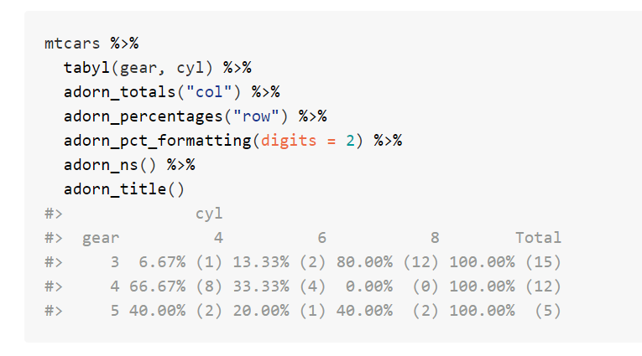
tabyl
https://github.com/sfirke/janitor/blob/master/vignettes/tabyls.md
Notes:
Tabyl is a better version of table.
This first creates a tabyl by gear (row) and cyl (col).
Then it adds a total column.
Then it adds percentages by row
Then it formats the percentages so that it’s rounded to 2 decimals
Then it adds the ns to all the cells
Then it adds the gear and cyl title.

Slide 71

Notes:
Also has a Slack channel

Slide 72
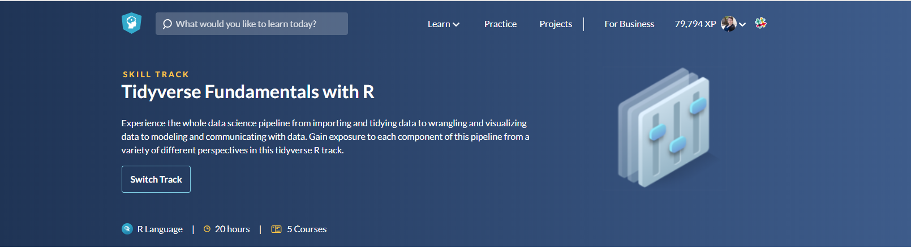
Importing Data in R (Parts 1 and 2)
Cleaning Data in R
Data Manipulation in R with dplyr
Joining data in R with dplyr
Exploratory Data Analysis in R

Slide 73
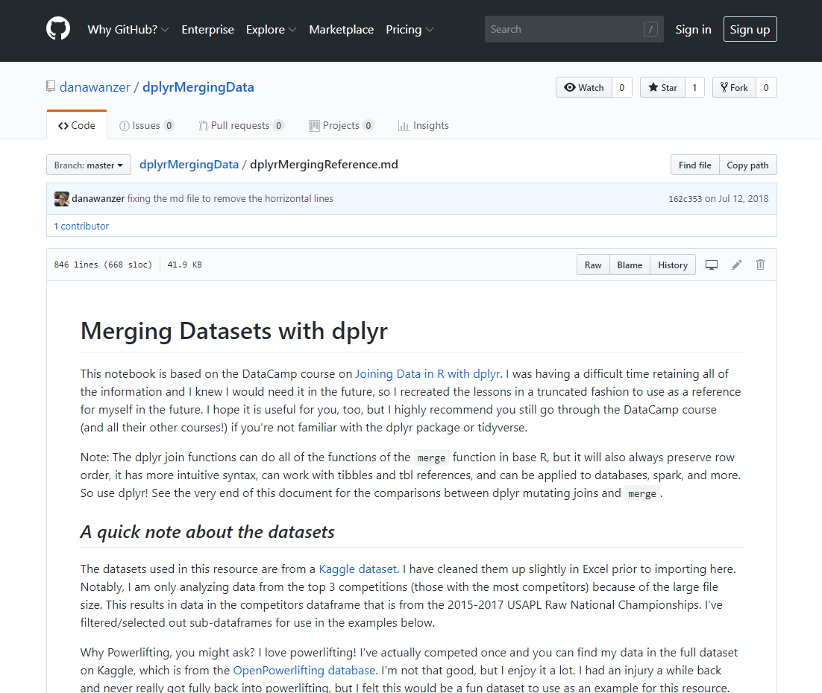
Notes:
One thing I haven’t gone over, but is a really useful tool to know if you work with multiple datasets is how to merge them. I’ve created a tutorial and reference sheet here that you can walk through if you’d like.

